Slide 1
LINKED-LIST

Slide 2
List: List refers to a linear collection of data items.
Linked-List: A linked list or a one way list is a linear collection of data elements called nodes, Where the linear order is given by means of pointers.
Each node in the list is divided in two parts: The first part contains the information and the second contains the address of the next node in the list called link field.
Single Linked List Representation:
The Linked List contains a list pointer variable called start pointer which contains the address of the first node in the list.
The null pointer signals the end of the list.
A special case is the list that has no nodes such a list is called the null list or empty list.
Start
Info
Info
NULL
LINK

Slide 3
Representation of Linked lists in memory.
Start=4 ,So info[4]=M
Link[4]=2 , so info[2]= C
Link[2]=8 , so info[8]=A
Link[8]=NULL
INFO
LINK
1
2 | C
3
4 | M
5
6
7
8 | A
8
2
NULL
4
START

Slide 4
Operations on linked-list:
1) Traversing
2) Insertion
3) Deletion
4) Searching

Slide 5
Insertion at the beginning #include<iostream> using namespace std; int main() { struct node { int data; struct node* link; }; struct node *temp,*head,*last,*temp2; int choice =1; cout<<"inserting at the start of list"<<endl; while(choice==1) { temp = new node(); cout<<"Enter the data of node"; cin>> temp-> data; temp->link = head; head=temp; cout<<"continue"; cin>>choice; } return 0; } | Insertion at the end #include<iostream> using namespace std; int main() { struct node {int data; struct node* link; } *temp,*head,*last,*temp2; int choice=1; last =NULL; cout<<"Inserting at the end of list"; while(choice==1) { temp = new node(); cout<<"Enter the data of node"; cin>> temp->data; if(last==NULL) head=last=temp; else { last->link =temp; last =temp; } cout<<"continue"; cin>>choice; } last->link =NULL; return 0; }

Slide 6
Insertion at the specified location #include<iostream> using namespace std; int main() { struct node { int data; struct node* link; }; struct node *temp,*head,*last,*temp2; int location; last =NULL; cout<<"Enter any location"; cin>>location; temp = new node(); cout<<"Enter the data of node"; cin>> temp->data; temp2=head; while (location-1>0) { location--; temp2=temp2->link; } temp->link =temp2->link; temp2->link=temp; return 0; }

Slide 7
 | Deletion of the node from any position(start/end) #include<iostream> #include<stdlib.h> //For using free function using namespace std; int main() { struct node {int data; struct node* link; } *temp,*head,*last,*temp2; int location; last =NULL; //First insert the nodes in linked list cout<<"Enter any location"; cin>>location; temp=head; if (location==1) { head =temp->link; free(temp); } else { int i=1; while(i<location-1) { temp =temp->link; i++; } temp2 =temp->link; temp->link = temp2->link; free(temp2); return 0; }

Slide 8
Searching any node #include<iostream> using namespace std; int main() { struct node { int data; struct node* link; }; struct node *temp,*head,*last,*temp2; int value,flag=0; //First insert the nodes in linked list cout<<"Enter value to search"; cin>>value; temp=head; while (temp->link!=NULL) { if(temp->data ==value) { flag =1; break; } else { temp = temp ->link; } } if(flag==1) cout<<“Value found”; else cout<<“Value not in the list”; return 0; } | Traversing a linked list #include<iostream> using namespace std; int main() { struct node {int data; struct node* link; } *temp,*head,*last,*temp2; last =0; //First insert the nodes in linked list temp=head; while(temp!=0) { cout<<temp->data; temp=temp->link; } return 0; }

Slide 9
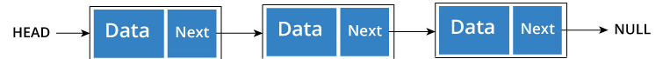
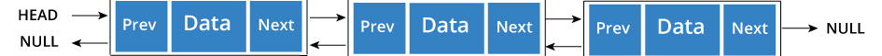
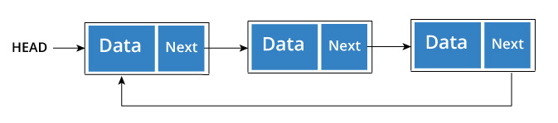
Types of Linked List
Singly linked list :-
Doubly/Two Way linked list :- is a list that has two references, one to the next node and another to previous node.
Circular linked list : A circular linked list is a variation of linked list in which the last element is linked to the first element. This forms a circular loop. A circular linked list can be either singly linked or doubly linked.
for singly linked list, next pointer of last item points to the first item
In doubly linked list, prev pointer of first item points to last item as well.

Slide 10
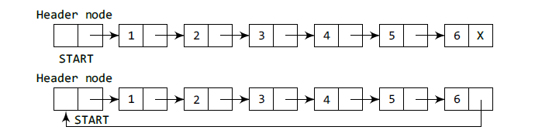
Types of Linked List
Header linked list :- A header linked list is a special type of linked list which contains a header node at the beginning of the list. So, in a header linked list, START will not point to the first node of the list but START will contain the address of the header node.
Grounded header linked list which stores NULL in the next field of the last node.
Circular header linked list which stores the address of the header node in the next field of the last node. Here, the header node will denote the end of the list.

Slide 11
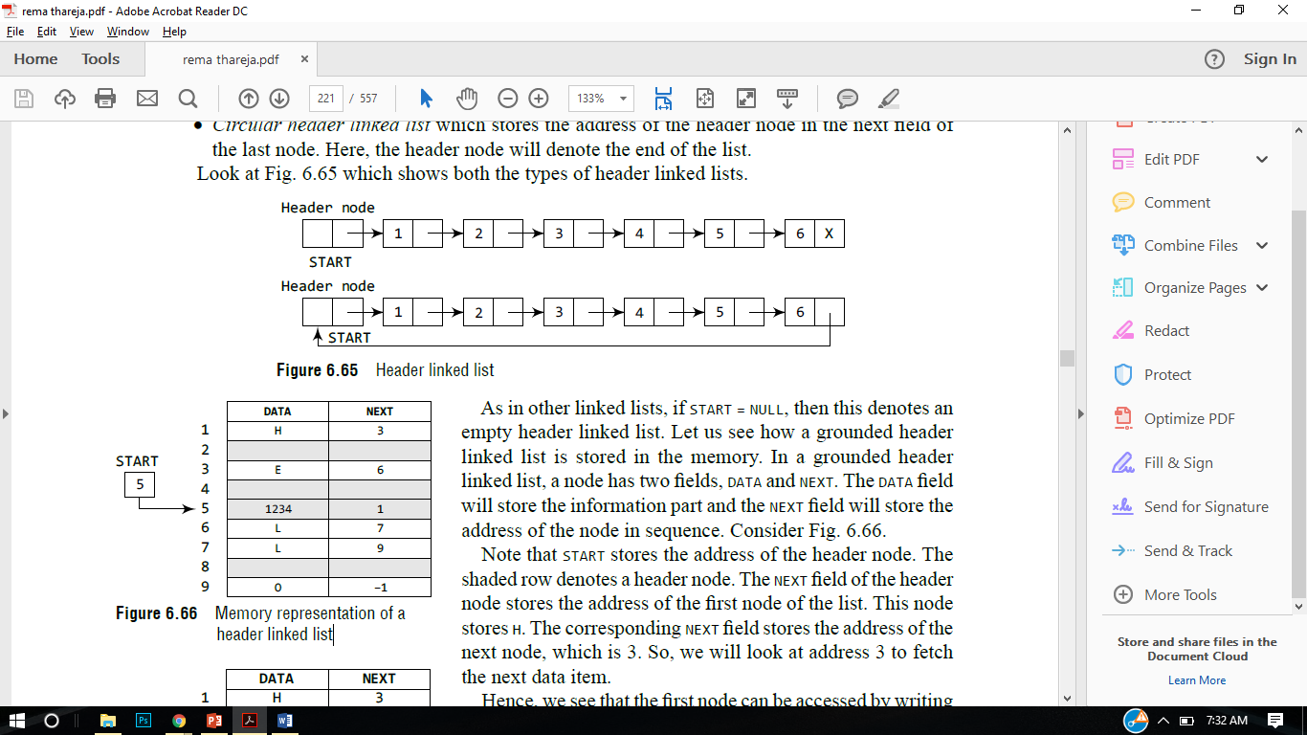
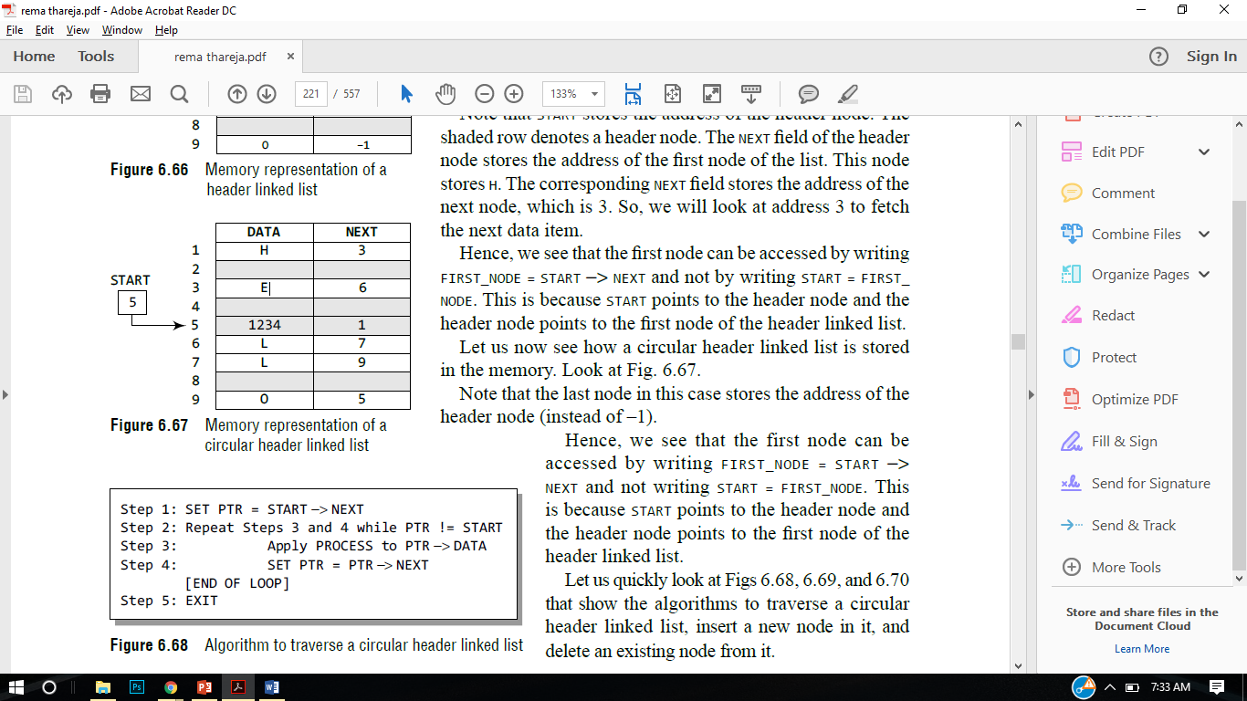
Memory Representation of Header Linked List

Slide 12
Operations on Two way / Doubly linked-list:
Doubly/Two Way linked list :- is a list that has two addresses, one to the next node and another to previous node.
1) Traversing
2) Insertion
3) Deletion
4) Searching

Slide 13
Insertion at the end #include<iostream> using namespace std; int main() { struct node { int data; struct node* next ; struct node* prev; } *temp,*head,*last,*temp2; int choice=1; last =0; cout<<"Inserting at the end of list"; while(choice==1) { temp = new node(); cout<<"Enter the data of node"; cin>> temp->data; if(last==0) { head=last=temp; temp->prev = 0; temp->next =0; } else{ last->next =temp; temp->prev = last->next; last=temp; | last->next =0; } cout<<“Do you want to continue?”; cin>>choice; }

Slide 14
 | last->next =0; } cout<<“Do you want to continue?”; cin>>choice; } Forward Traversing temp =head; while(temp!=0) { cout<<temp->data; temp=temp->next; } Backward Traversing temp =last; while(temp!=0) { cout<<temp->data; temp=temp->prev; }

Slide 15
Deletion from two-way linked list #include<iostream> using namespace std; int main() { struct node { int data; struct node* next ; struct node* prev; } *temp,*head,*last,*temp2; int choice=1,position; last =0; // Insert the nodes using the previous code cout<<"delete the node from position "; cout<<"Enter the position"; cin>>position; temp=head; if(position==1) { head =temp->next; free(temp); }

Slide 16
 | else { int i=1; while(i<position-1) { temp =temp->next; i++; } temp2=temp->next; temp->next = temp2->next; free(temp2); } temp=head; while(temp!=0) { cout<<temp->prev<<" "; cout<<temp->data<<" "; cout<<temp->next<<" "<<endl; temp=temp->next; } return 0; }

Slide 17
Searching from two-way linked list #include<iostream> using namespace std; int main() { struct node { int data; struct node* next ; struct node* prev; } *temp,*head,*last,*temp2; int choice=1,position,value,flag=0; last =0; // Insert the nodes using the previous code cout<<"Enter the value you want to search"; cin>>value; temp=head; while(temp!=0) { if(value==temp->data) { flag=1; break; | } else { temp=temp->next; } } if(flag==1) { cout<<"Element found"; } else { cout<<"Element not found"; } return 0; }

Slide 18
Which of the following is false about a doubly linked list?
a) We can navigate in both the directions
b) It requires more space than a singly linked list
c) The insertion and deletion of a node take a bit longer
d) Implementing a doubly linked list is easier than singly linked list

Slide 19
In a circular linked list
a) Components are all linked together in some sequential manner.
b) There is no beginning and no end.
c) Components are arranged hierarchically.
d) Forward and backward traversal within the list is permitted.

Slide 20
A linear collection of data elements where the linear node is given by means of pointer is called?
a) Linked list
b) Node list
c) Primitive list
d) None

Slide 21
Questions
Ques : How is Linked List represented in memory? Write a code to insert the node in linked list.
Ques : How many types of linked list are there? Write a code to implement two way / doubly linked list.
Ques : Write a code to search an element from the linked list and traverse the linked list.
Ques : Write some differences in linked list and arrays.
Ques : How is doubly Linked List represented in memory?
Ques : Write a code/algorithm to delete an element from the specified location.

Slide 22
#include<iostream>using namespace std;class A;class B{ //definition of class B int b = 2;public: void max(A x, B y); };class A{ //definition of clas A int a = 1;public: friend void B :: max(A , B ); //ma x is friend function};void B ::max(A x, B y){ if (x.a > y.b) cout<< " x is greater"; else cout<<"y is greater";}//MEMBER OF CLASS Bint main(){A x;B y,c;c.max(x,y);}

